Slide 1
BLIS-KENYA

Slide 2
INTRODUCTION
BLIS (Basic Laboratory Information System) Kenya, is a fork of C4G BLIS an open source Web-based system that can be implemented in a local, district, or national laboratory.
The system efficiently manages the work flow in the lab through integrating with the hospital EMR's, automatically receiving lab test requests from the clinicians/doctors and returning the results.
The system tracks the movement of specimens providing respective turn-around-times for tests, and provides individual workload monitoring, test reporting and quality control.

Slide 3
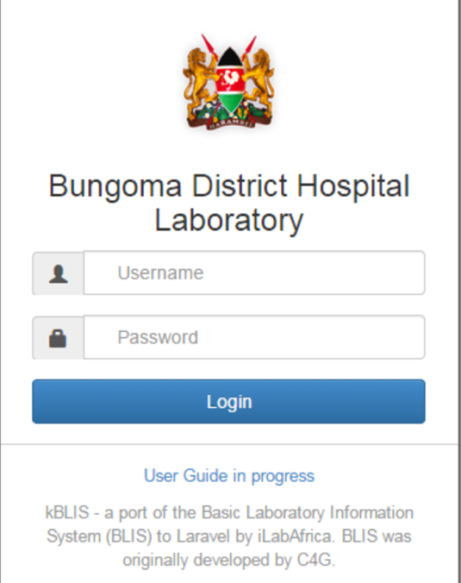
Getting started with BLIS
To start the Basic Laboratory Information System, you must click on the bookmark saved on the web browser e.g. Google Chrome or Mozilla Firefox. You will then see a page requesting login information. You must then enter your credentials to proceed.

Slide 4
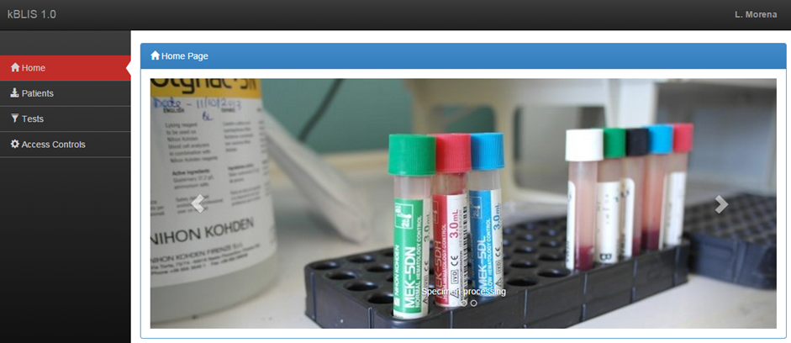
Continuation….
On successful sign-in, you should see such a page as this.

Slide 5
Patient listing and registration
This section allows for patient registration in the case of referred patients or those not registered in the hospital EMR system. A listing of all the patients available is shown as captured below.

Slide 6
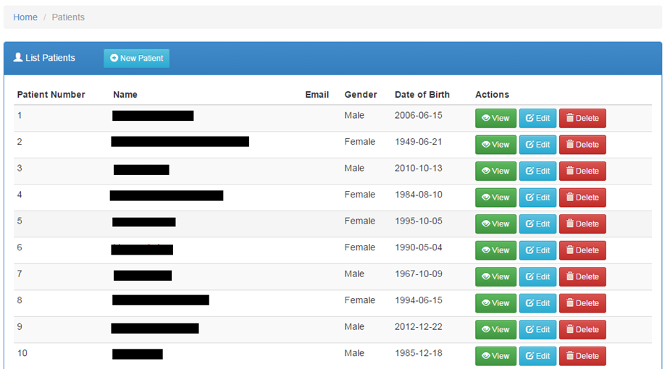
Listing patients
From the homepage, click the patients tab on the navigation menu for the patients list portlet to be shown

Slide 7

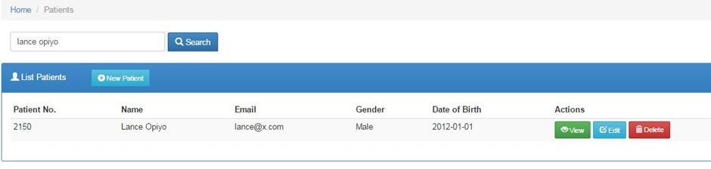
Searching for a patient
1. Begin typing the patient name on the search field
2. The patient details searched will be loaded with matching values e.g.

Slide 8


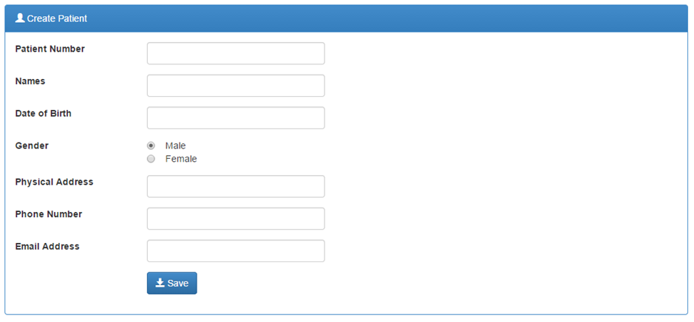
Patient Registration
To register a patient, click on the button at the top of the blue portlet.
After completing the form, click the button at the bottom of the form. Using the Save button will instantly save the details to the system.

Slide 9

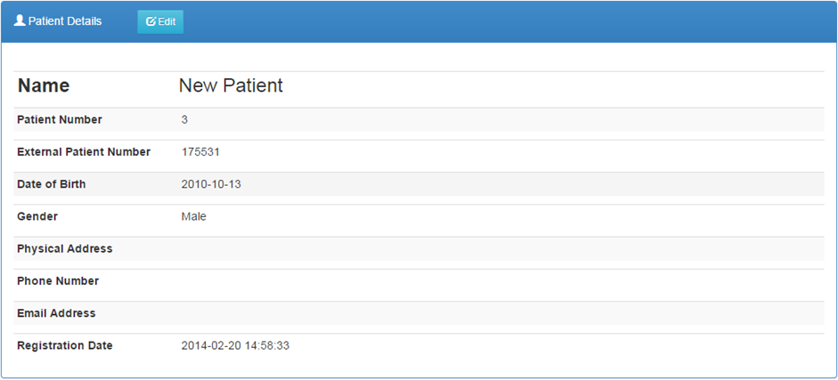
Viewing a patient’s details
1. Click the button on the Actions column with the corresponding row of the patient listed to see the details as shown below.

Slide 10

Continuation…
2. To get back to the patients list, click on Patients hyperlink on the breadcrumb.

Slide 11

Editing a patient’s details
1. On the patients list, click on the button
2. After making your modifications, click the button to push the changes to the system
3. An alternative way to edit patient details is to use the button on the patients list then click
on the button once the details have been displayed.

Slide 12
Laboratory tests
Different medical systems have distinct stages and processes of conducting medical test. This document will track the life cycle of a medical test on-board iBLIS.
After receiving test request from a patient or other embedded systems the immediate step is to book for the test via the laboratory system. The initial stage of capturing the test details is most important stage. In essence, accurate data capturing will streamline the logical steps to ensure that what you test is what you meant to test, and that the final test report meets the client’s needs and expectations.

Slide 13

Listing ordered tests
Click the tab on the navigation menu to load a list of all ordered tests.

Slide 14
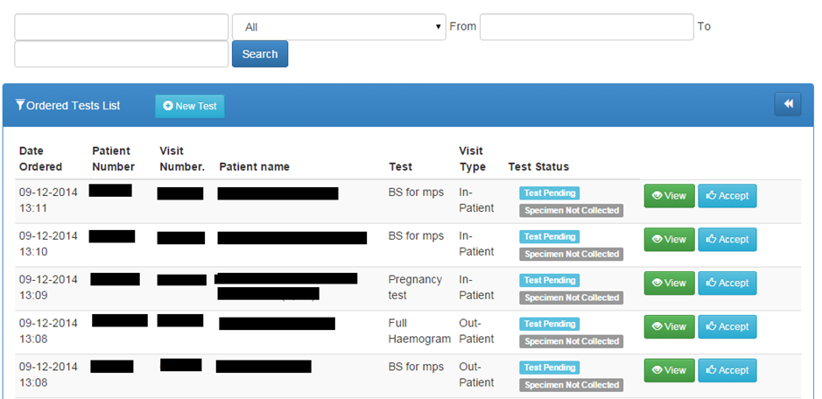
Searching for a lab request
Below is the first interface during the testing process. Once you have your search parameters in place, click the search button.

Slide 15
Booking a test
For referrals to the lab and tests that do not originate from the hospital EMR system, lab requests have to be created at the lab.
The iBLIS system can accept and initiate test requests through different approaches discussed below.

Slide 16

i) By use of the Tests Link
1. Click the button to launch the test order form.
2. Select the desired patient by tying the patient Id or Name or by clicking the GO button to list the available patients.

Slide 17
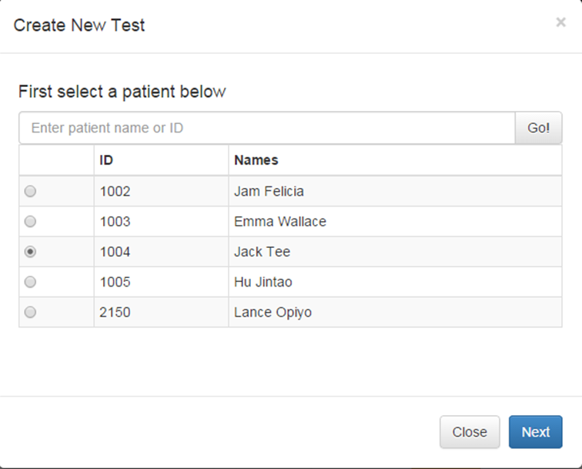
Continuation….

Slide 18

Continuation….
3. Click the button to launch the new test order form.
4. In the New test page, input the visit type, the requesting physician and from the listed tests, select the desired test(s).

Slide 19
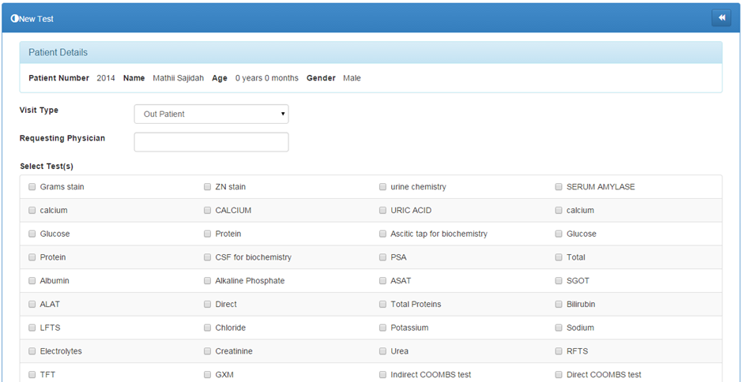

Continuation….
5. Click the button to save the details.

Slide 20

ii). By use of the patient's details page
A test can be booked directly from the patient details page. This page can be accessed after selecting the patient at subject of the tests.
1. Click on the link on the side bar navigation menu on the left of the screen.
2. Identify the desired patient and click the corresponding button to load the Patient Details page.

Slide 21
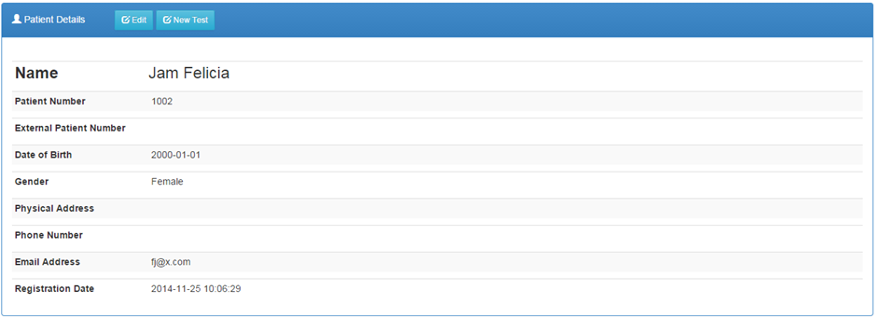
Continuation….
Click the button

Slide 22
iii). By use of an external system
BLIS will have a module through which a test order can be invoked by multiple external systems. This will only happen if the systems can integrate and map fully with BLIS.
External system configuration and integration with BLIS will depend on the available systems in any given hospital.
All the embedded systems will fully be tested to ensure a smooth running of BLIS and the particular system at stake before inter-dependability can be authorized.

Slide 23

Viewing a lab test request
1. On the ordered list of tests, click on the button on the corresponding row of the request.
2. To get back to the test list, click the icon on the top right corner of the ‘Test Details’ portlet.

Slide 24
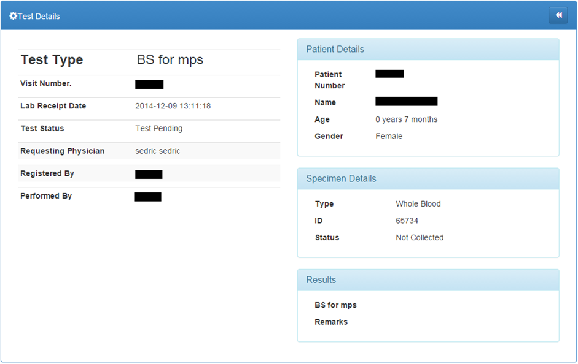
Continuation….

Slide 25


Accepting a specimen
Before the testing process is started the acceptance of the specimen must be registered in the iBLIS system. This will be achieved through;
1. Click on the link on the side bar navigation menu on the left of the screen.
2. Select the test of interest and check where Test Status is
3. Click on the button to acknowledge the specimen.
4. This will change the specimen status to and the button to the test will show, plus a button in case the specimen is deemed unsuitable.

Slide 26
Rejecting a specimen
Specimen can be rejected on several levels in iBLIS.
The first level is during specimen collection. Mistakes can be made hence making the specimen unsuitable.
On other occasions the specimen samples can be damaged or contaminated during testing.
If the collected specimen cannot progress to testing and actualize the test due to various reasons it can then be rejected through;

Slide 27


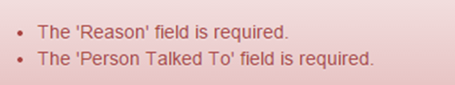
Continuation….
1. Click on the link on the side bar navigation menu on the left of the screen.
2. Select the test of interest and check where Test Status is
3. Click on the button to reject the specimen.
4. Fill in the form appropriately then click the button at the bottom to complete the rejection.
5. You will be notified of any errors during rejection like

Slide 28
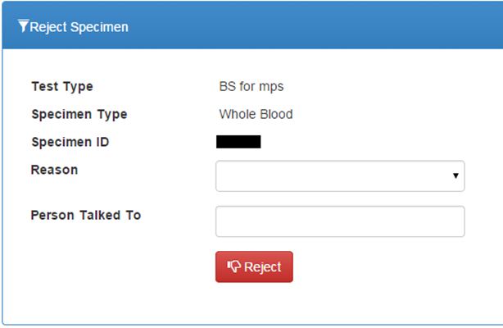
Continuation….

Slide 29


Referring a Test
The accepted specimen can be referred via;
1. Click on the link on the side bar navigation menu on the left of the screen.
2. Select the test of interest and check where Test Status is and
3. Click on the button.
4. Fill in the form
5. Click the button
NB: The process is similar for both referred-in tests and those referred out. You just have to indicate whether it is a refer In or out

Slide 30
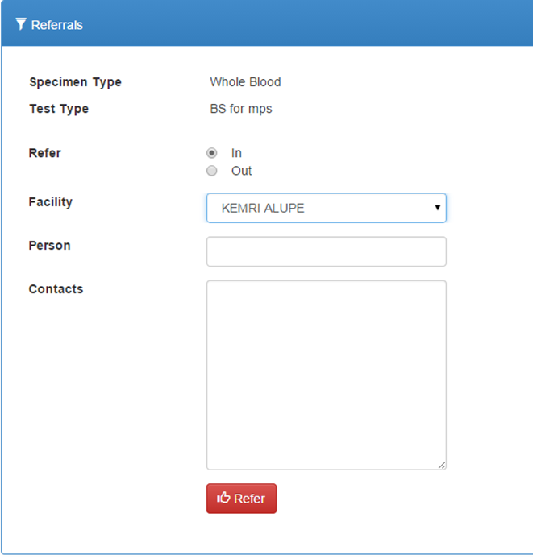
Continuation…..

Slide 31



Starting a Test
A test can only be started if the collected specimen is suitable
1. Click on the link.
2. Select the test of interest and check where Test Status is and
3. Click on the button to commence the testing process. The test status changes to

Slide 32


Entering the results
After a successful test, the results are then recorded into iBLIS. The page can be accessed via;
1. Click on the link.
2. Select the test that whose results are ready.
3. Click on the button to feed the results into the system
4. Fill the results form
5. Click the button to save the results to the system

Slide 33
Entering test results for culture worksheet
1. Click on the link to access a test which has test type with culture worksheet
2. Select the test that whose results are ready.
3. Click on the button to feed the results into the system.
4. Fill in the results form .
5. To feel the culture work sheet proceed below:

Slide 34
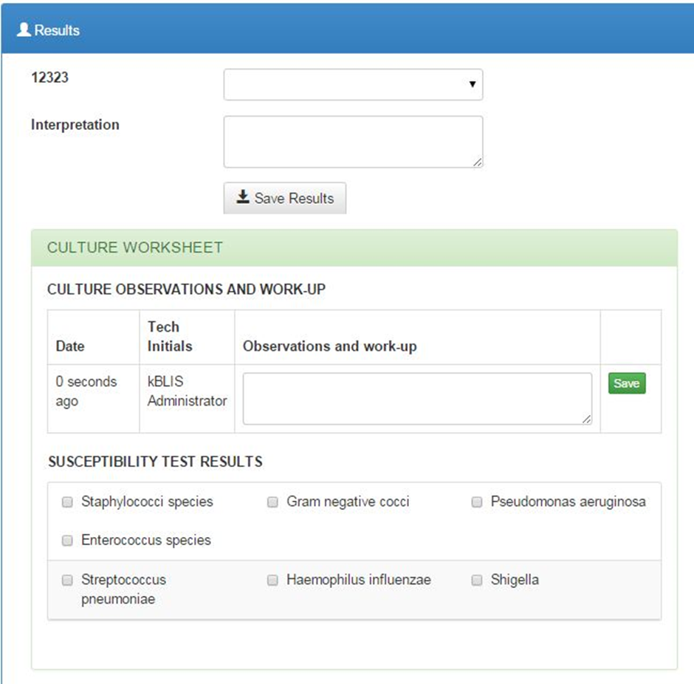
Continuation….

Slide 35

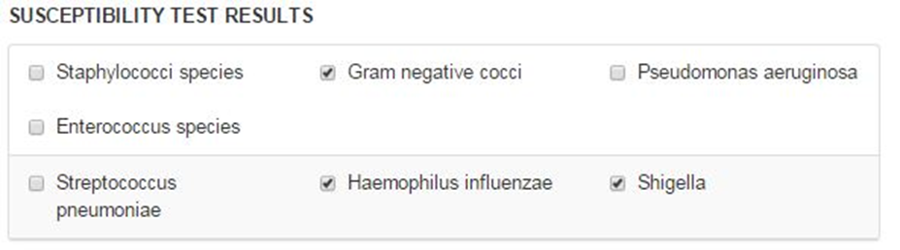
Continuation….
6. After feeling the feeling the observations and work-up section click to save the observation into the system.
7. Continue to the susceptibility test results section to select the applicable

Slide 36
Continuation….
8. Once you check any box for susceptibility test results then the selected test result entry form will be populated below as shown below for
9. Fill the form as deemed and click the save button on the particular section.
10. Finally click the button to save the results to the system.

Slide 37

Full Haemogram results on Celltac F machine
1. Click the button on the corresponding test on the list of tests.
2. On the Celltac F machine; press Print Results button to send the results from the Celltac F machine to the computer.
3. Click the button on the results panel to autofill the form with the test results as shown below.
4. Click the button to save the results to the system.

Slide 38


Editing Test Results
If the test results were entered incorrectly they can be edited. This can only be done before test verification following the steps below;
1. Click on the link.
2. Select the test whose results are to be edited and test status is
3. Click on the button to make the changes.
4. Make the necessary modifications on the form presented.
5. Click the button to save the changes.

Slide 39


Verifying Test Results
A test can only be verified if all the above processes and conditions are correctly actualized.
The results will be compared against preset criteria designed for verifying the particular test;
1. Click on the link.
2. Select the test whose results are to be verified and test status is .
3. Click on the button to proceed to the test details page.
4. Click on the button on the test details page to commit the verifications.

Slide 40
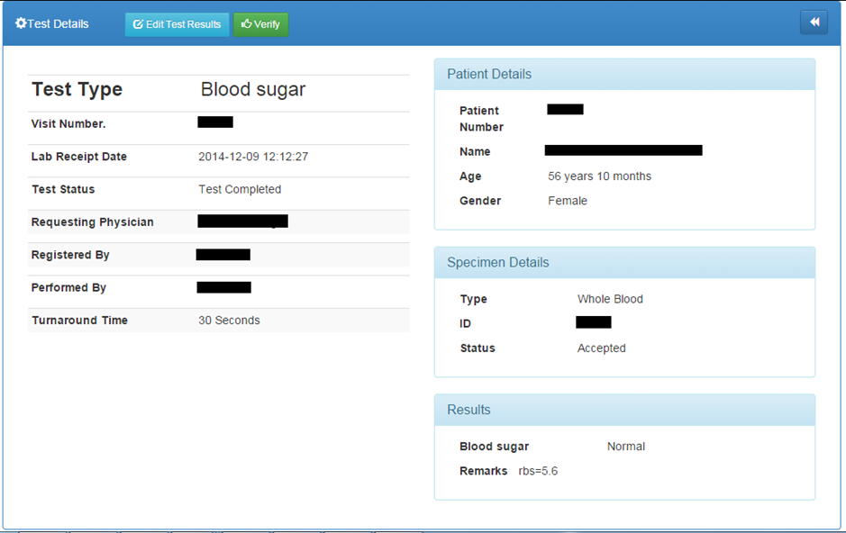
Continuation….

Slide 41

Reports
1. Click on the link to open the reports module.
Daily Reports- The Patient Report and Daily Log should be run every day.

Slide 42

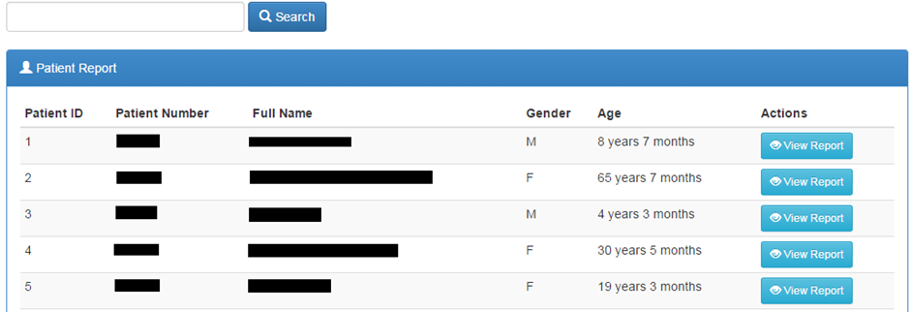
Patient Report
1. Click the link on the Reports sub-menu to open the patients reports listing

Slide 43




Continuation….
2. Search for the patient by Patient Name, Patient Number, or Patient ID.
3. Click the button to start search.
4. Select the patient you want from the list if more than one patient matches your search criteria.
5. Click to see all data for that patient.
6. Click to filter the report and to export to word document

Slide 44

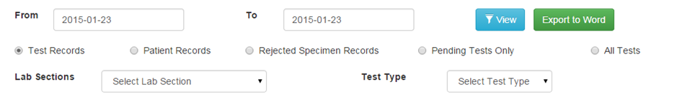
Daily Log
1. Click the sub-menu under reports to view daily logs.
2. Set the date range to reflect the log to print. You can run a report of the day’s activity by patients seen (by clicking Patient Records), or by tests run (by clicking Test Records) or rejected specimens (by clicking Rejected Specimen Records).

Slide 45
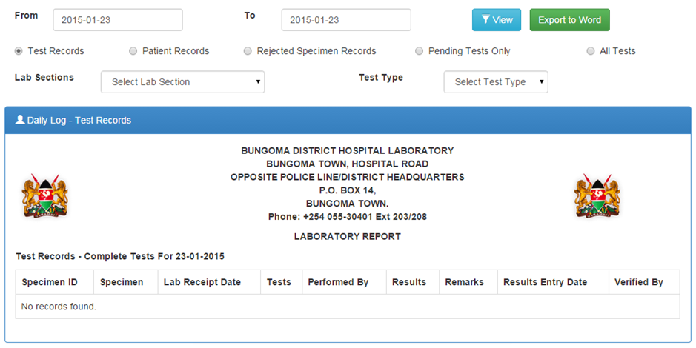
Test Records
You can choose to run a log for one lab section or for one type of test, for all tests or pending tests only. The report loads with Export controls at the top of the page

Slide 46




Patient Records
1. Click on the checkbox
2. Apply the filter parameters, such as date ranges
3. Click the button to load the report
4. Click the button to toggle the summary
5. Click the button to export the report to word document for further processing

Slide 47

Rejected Specimen Records
1. Click the checkbox then button to load the report

Slide 48
Aggregate Reports
These are accrued summaries over a period of time.

Slide 49


Prevalence Rates
Gives the prevalence of a particular laboratory test result based on the number of tests done and the results.
1. Click the sub-menu to load the report. By default, the report loads prevalence rates for the current year .
2. Set a date range to view infection graph and prevalence rates. You can also specify the lab section.
3. Click the button to load the report with the filters you defined
4. You can view a numeric summary of the prevalence rates by clicking the button to reveal the numeric data.
5. You can click on a test on the legend section to hide its graph

Slide 50

Counts Report
Generates a report for a particular time period of the number of tests and specimens both grouped and ungrouped.
1. Click the sub-menu to launch the counts reports options

Slide 51
Test Counts (Ungrouped)
Shows for each test, the number of complete vs pending tests overtime

Slide 52


Test counts (Grouped)
This is a report that groups tests according to various parameters such as lab section, gender, age ranges then counts the numbers for each while showing the total tests run.
Click the checkbox then to load the report

Slide 53
Specimen counts (Ungrouped)
It is a count for accepted vs rejected specimen
Click the then to load the report

Slide 54

Specimen Counts (Grouped)
Click the checkbox then to load the report

Slide 55



Turnaround Time Report
Allows you to see actual turnaround times between test order and completion for all or specific tests.
1. Click the sub-menu to load the report
2. Set a date range then click the button to filter the report. The default is data for the current year.
3. You can choose to run a log for one lab section or for one type of test. The default settings are test records, all sections, and all tests.
4. The report loads with Export controls which can be accessed by clicking the icon where the chart can be exported to PDF document or as an image.

Slide 56

Infection Report
Allows you to generate reports of infections by patient age and gender.
1. Click sub-menu to load the report. By default, it loads data counts for the current year.
2. Set a date range or select one Lab Section, or all sections to see all test results after clicking the button.

Slide 57

Surveillance Report
Allows you to generate surveillance report by laboratory and test outcome.
1. Click sub-menu to load the report. By default, it loads surveillance for the current month.
2. Set a date range to see all test results after clicking the button.

Slide 58

Quality Control Report
Allows you to generate quality control report by range and control type.
1. Click sub-menu to load the report. By default, it loads quality control report for the current month.
2. Set the date range and select the control type to see all the results after clicking the button.

Slide 59

User Account
Allows users signed into the system to update their accounts such as passwords for security reasons, adding profile pictures and so forth.
Click the sub-menu to open the user details page.

Slide 60


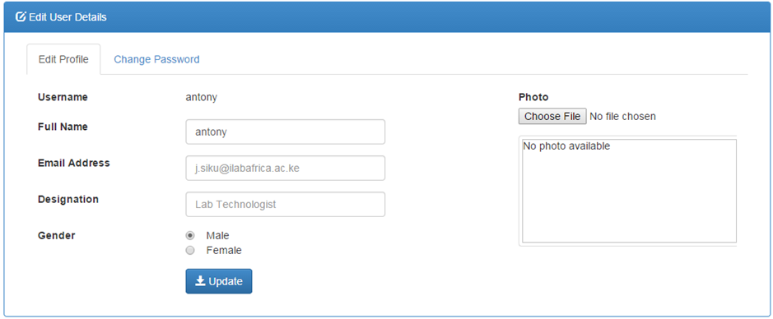
Editing Your User Profile
1. Click the tab on the tabbed bar
2. Make modifications to the details using the form provided
3. Click the button to save the changes

Slide 61

Changing your Password
1. Click the , change password tab.
2. Make necessary modifications to the data. Remember the new password MUST match retyped password.
3. Click the button to save the changes

Slide 62


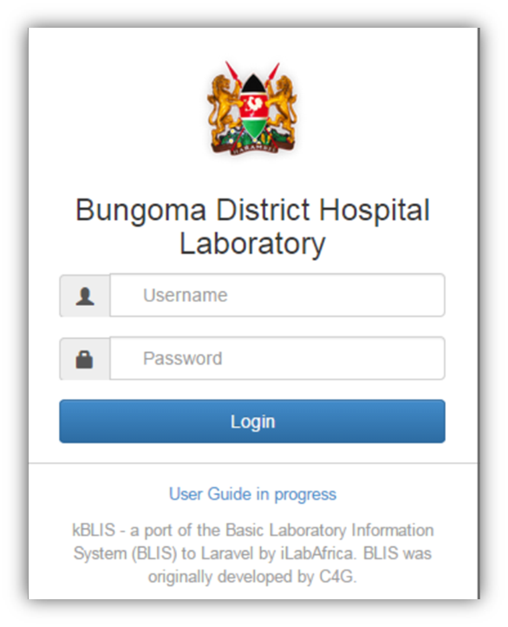
Signing out of BLIS
1. Go to the top right corner of the top bar where your username is indicated .
2. Click on the username to open a menu with and links.
3. Click the Logout link to sign out. You should be redirected to the login page of BLIS.

